Slide 1

A project on
‘ Cafeteria Management System ’
Supervised BY Sumi Khatun Department of CSE Bangladesh University of Business and Technology
Team Member:
Shamiul Islam 241
Hasan AL Mahmud 239
Khaled Hasan 266
Hasseb Rahman 276
Dept. of CSE BUBT

Slide 2
Roadmap
Introduction
Languages & Tools
Benefit of cafeteria management
Features.
Overview Of Project.
Software Model
Physical description
Experience Future plan
Conclusion

Slide 3
Introduction
By using this software, A shop owner can store and sell his/her product to/from the shop. The software will handle the procedure needs to store, sell, calculation, store records of sale and store of products.
Objective :
To maintain a shop’s transaction in Computerized System.
To give a shop owner a better facility.
To inform the owner about the storage of product.

Slide 4
Languages & Tools
C
Sublime Text Editor
Code::Blocks
Atom

Slide 5
Benefit of BUBT cafeteria management
Tracking Inventory
Purchasing
Manage planning and Forecasting
Reduce the time for managing Inventory

Slide 6
Features
Add, update and Delete goods
Search product and user details
Easily calculate bill
User account to control the access and maintain security
Easy and fast retrieval of information
Decrease the load of person involve in existing manual system
Accuracy in work
Creating & Changing issues at ease

Slide 7






Overview
Cafeteria Management System
Admin / Seller
Add Goods
Search Items
Stock Monitor
Calculate Bill
Edit Goods
Delete Goods

Slide 8
Software Model
The methodology, we used to develop this system is
Incremental Model.
The Development of Project is included system planning requirement analysis, system design, programming, system testing and evaluation of the project in
weekly basis.

Slide 9
Physical Description Of The Project

Slide 10
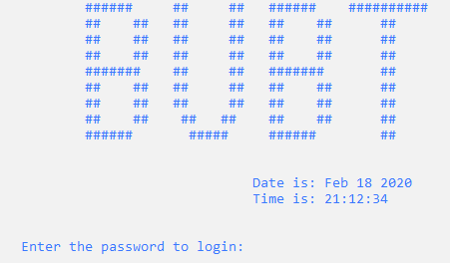
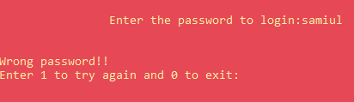
First Login Window
Login windows required a specific password to accessing main menu and other services. If wrong value is entered, it shows error message.
And it tells to enter password again or exit.
Otherwise, it runs the Main
Windo.

Slide 11
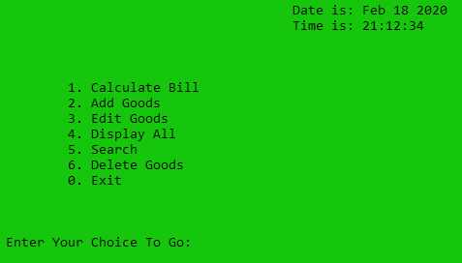
Main Menu Window
After Successful Login, The Main Window will be shown
Calculate bill
Add Goods
Edit Goods
Display All
Search
Delete goods
Exit
.

Slide 12
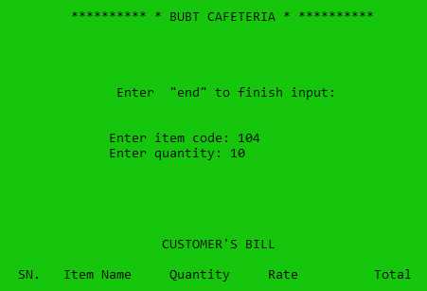
Calculate Bill
After Successful press 1. The calculate Window will be shown.
Enter Item code
Enter Quantity
.

Slide 13
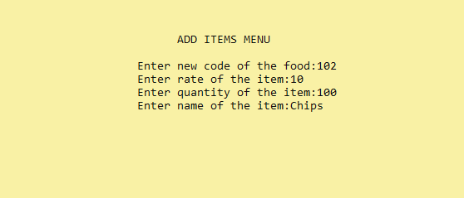
Add Goods
After Successful press 2. The Add goods Window will be shown
.
Enter new code of the food
Enter rate of the item
Enter quantity of the item
Enter name of the item
.

Slide 14
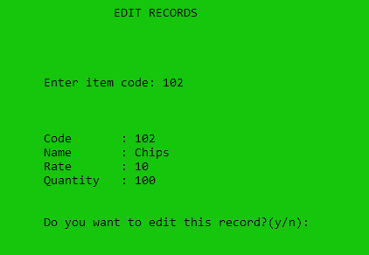
Edit Goods
In this window, admin can edit new records, modify existing information and can delete if need. Search Field helps to find goods easily.
Code
Name
Rate
Quantity
.

Slide 15
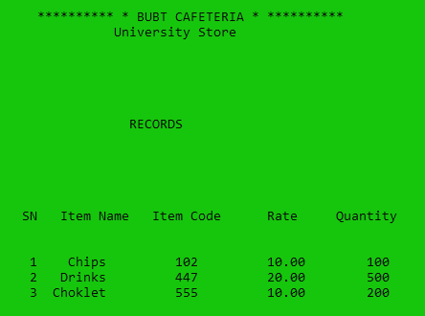
Display All Item
In this window, admin can see all product easily.
Records
.

Slide 16
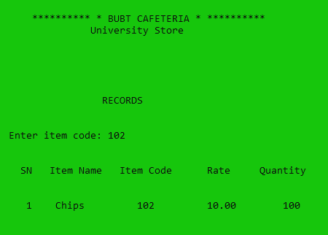
Search Items
In this window, admin can search item. Search Field helps to find the product easily.
Item code
Item name
Item Rate
Item quantity
.

Slide 17
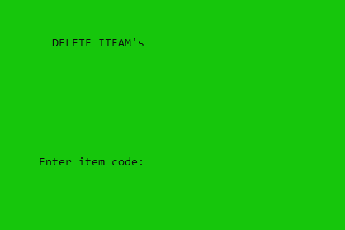
Delete Goods
In this window, admin can delete item goods easily
Delete items
Enter item code
.

Slide 18
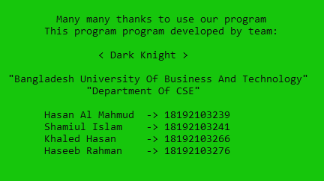
Exit
In this exit window, it shows a thanks message, team name and also shows all the team member who are developed this project.
Exit

Slide 19
Experience
Throughout the entire project we have learned:
Programming skill, system
design skill, and Software Development Model.
How Create a Software Combining small programs

Slide 20
Future plan
In future, our aim to develop it for maintain a shopping market in actual field and extends the system.

Slide 21
Conclusion
This software is successfully done to maintain a shop’s transaction.
The project is completed that follow the Incremental Model.

Slide 22
Reference
[1] https://www.tutorialspoint.com/error.htm?title=mysq
[2] https://www.codewithc.com/
[3] https://stackoverflow.com/
[4] https://www.geeksforgeeks.org/

Slide 23




